Slide 1
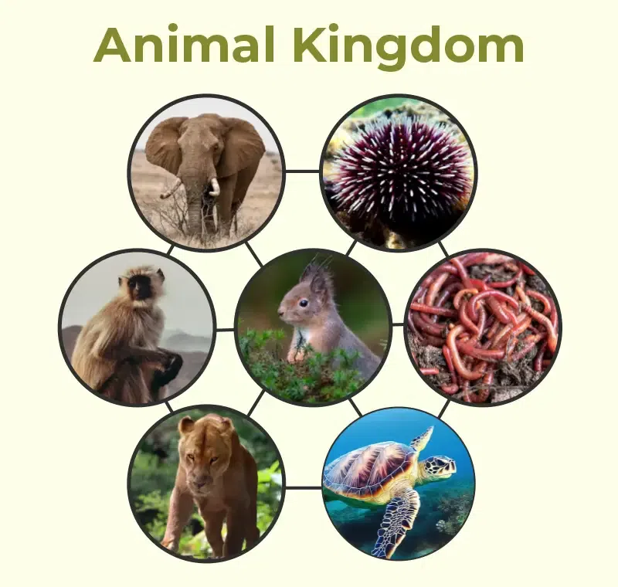
Animal Classification

Slide 2
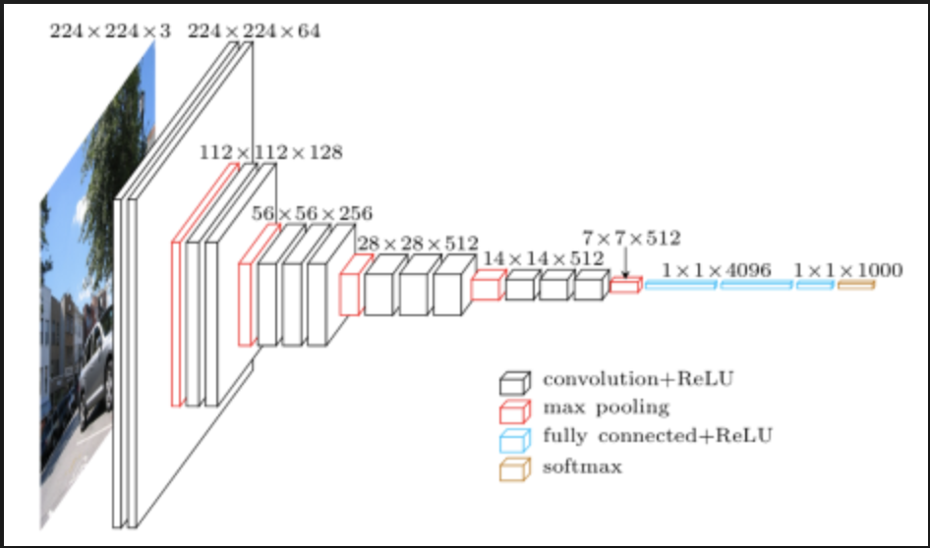
What, How, and Why?
Classify multiple different types of animals using convolution image classifier
Use Visual Geometry Group- VGG16- model and transfer learning
A pre-trained model on ImageNet
Help identify animal pictures taken by Wildlife Conservatory
Identify potential new species as well as endangered species

Slide 3
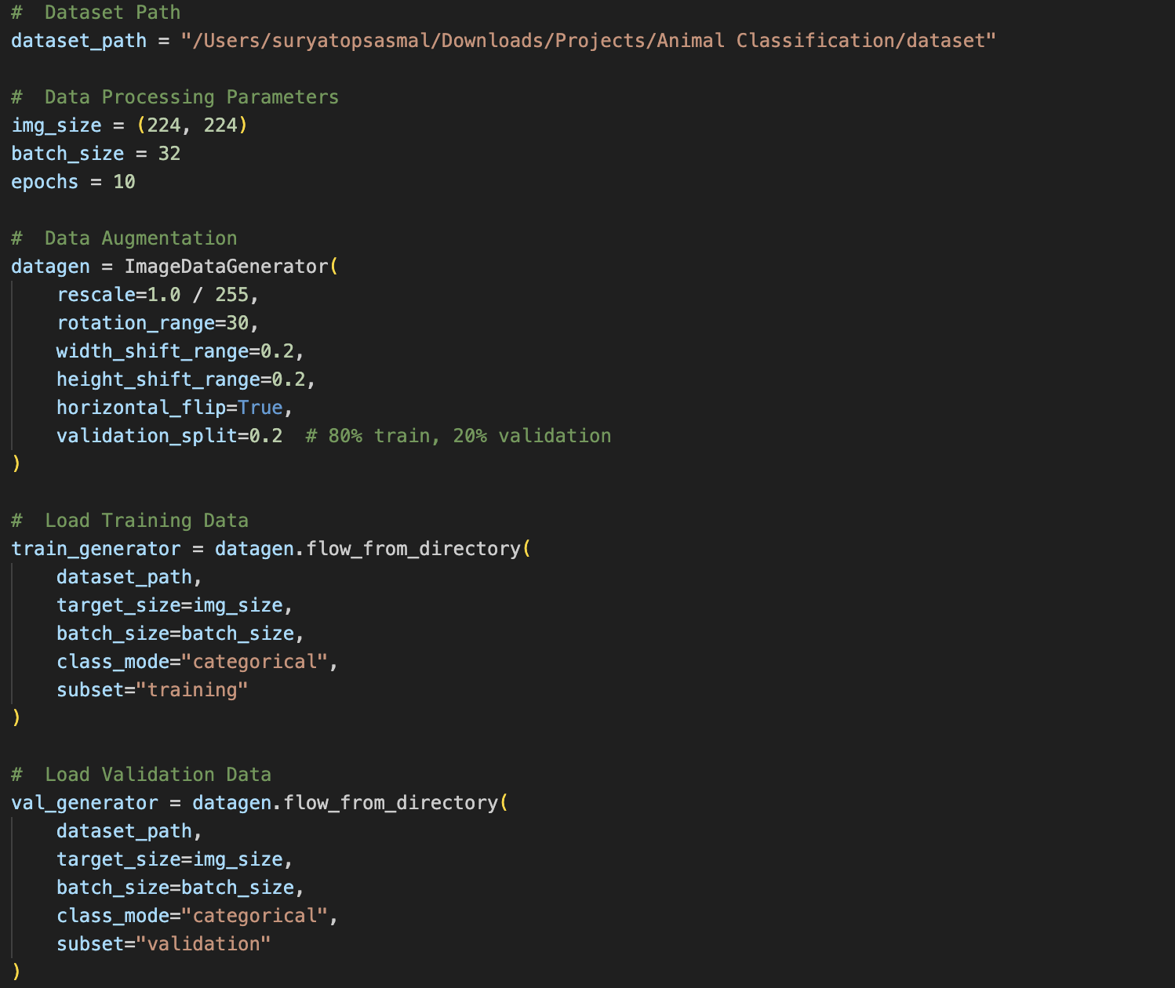

Slide 4
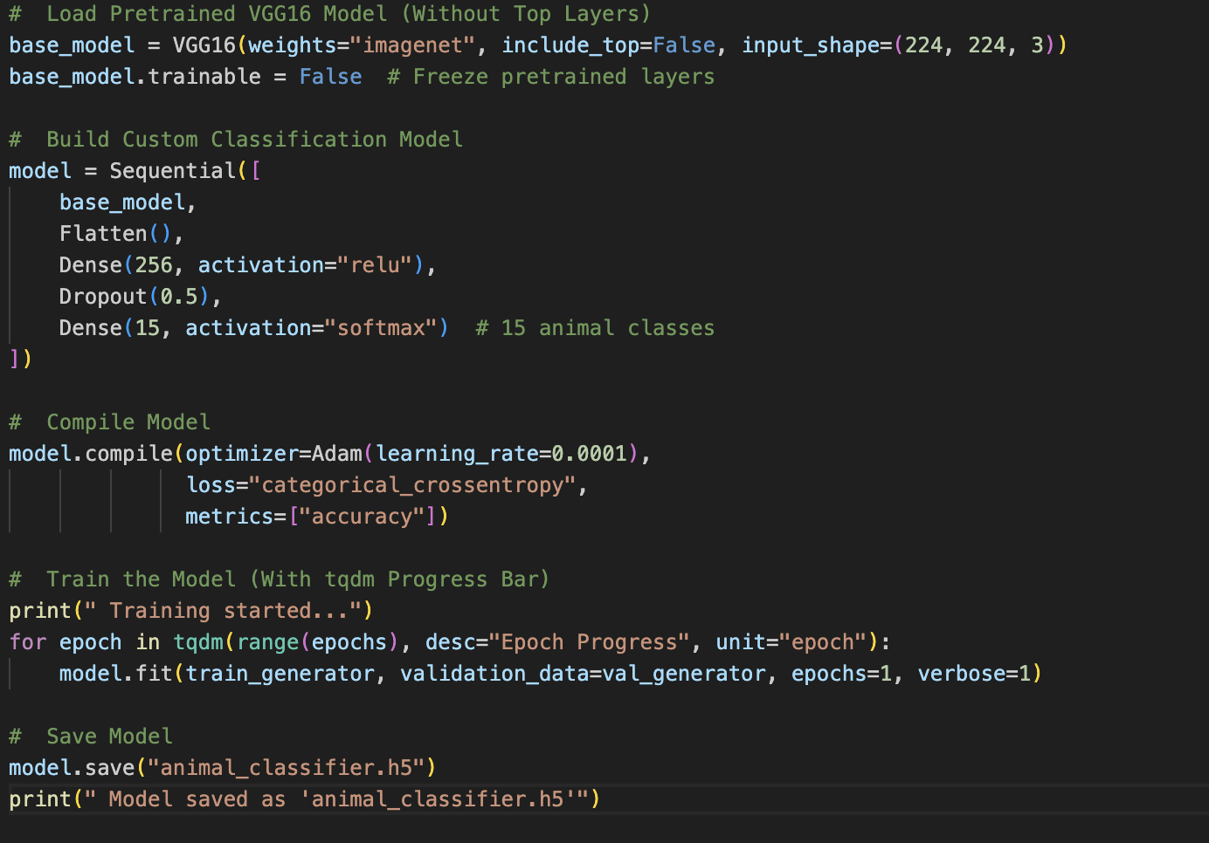
Training the Final Model

Slide 5
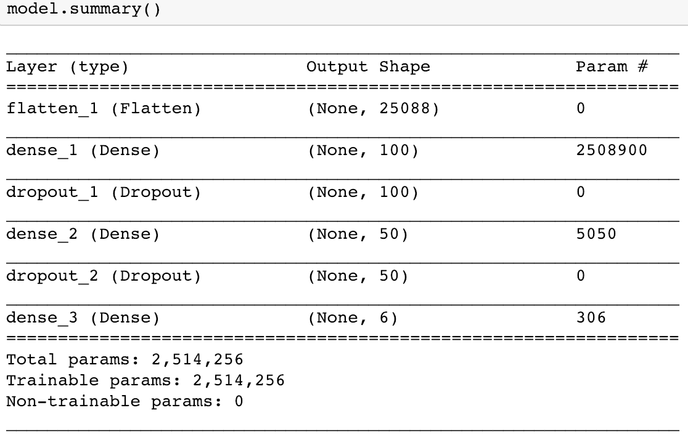
Our Best Model’s Summary

Slide 6
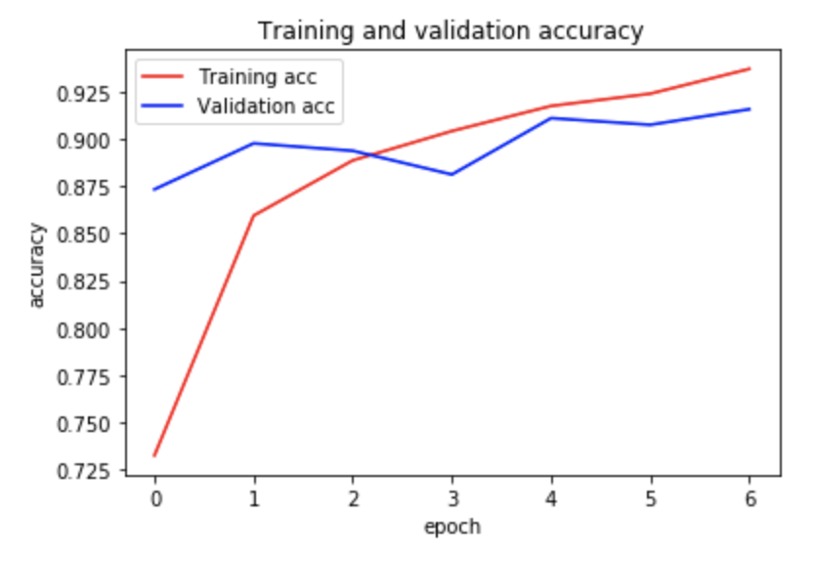
Training and Validation: Accuracy

Slide 7
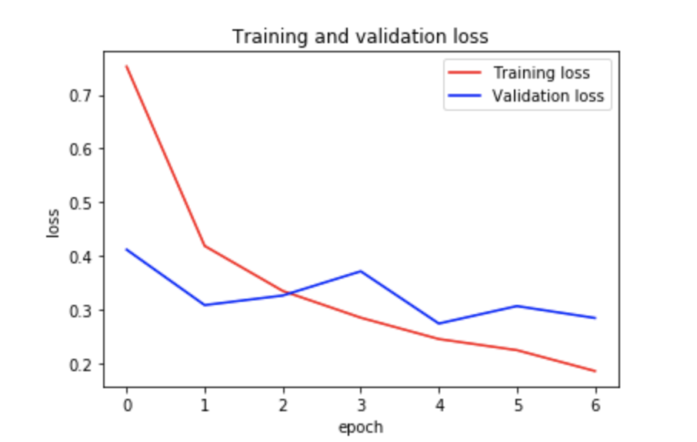
Training and Validation: Loss

Slide 8
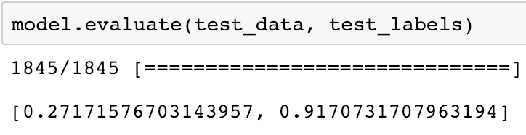
Evaluating Our Model on the Unseen Testing Set

Slide 9
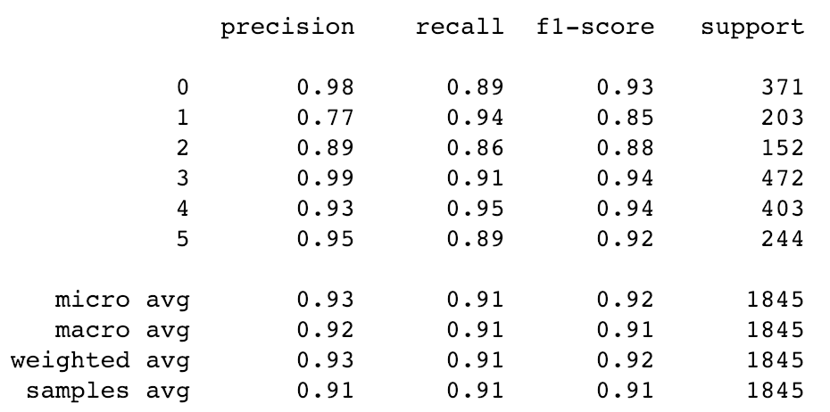
Classification Metrics
Butterflies:
Chickens:
Elephants:
Horses:
Spiders:
Squirrels:

Slide 10
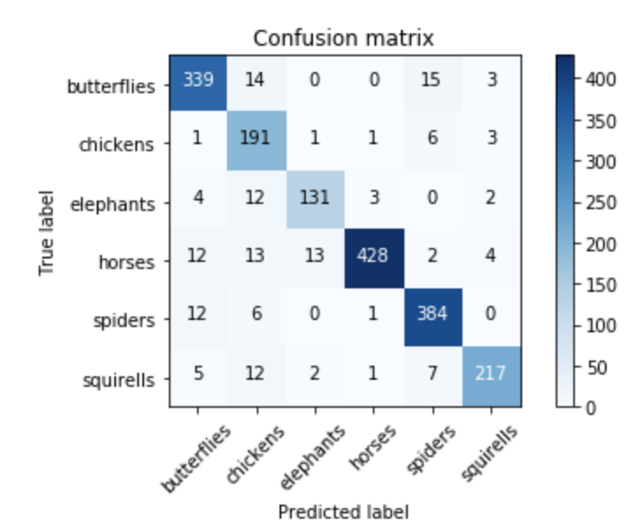
Confusion Matrix

Slide 11
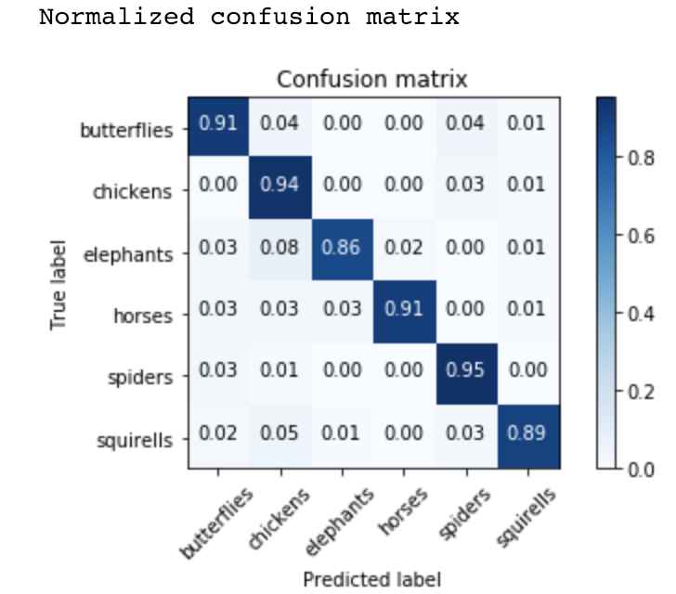
Confusion Matrix with Normalization

Slide 12
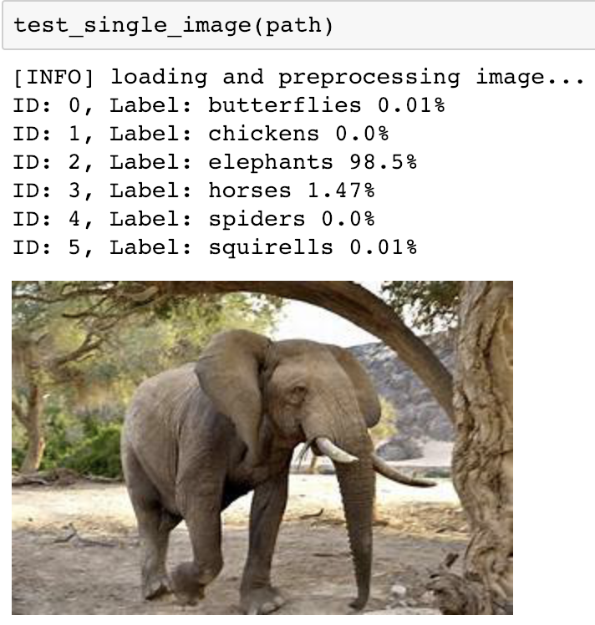
Let’s check prediction of Picture

Slide 13
Thank you!!
Name: Suryatop Sasmal
Collage: Parul University

